Slide 1
Course Code: MEG411
Course Title: Refrigeration and Air Conditioning
Course Unit: 2
Lecturer: Dr. S.O. Giwa
Course Outline:
Fundamentals of vapour compression refrigeration. Analysis of refrigeration cycles. Heat pumps. Refrigerants and their properties. Absorption refrigeration. Principles of air-conditioning with emphasis on thermodynamics processes involving air-water vapour mixture.

Slide 2
Course objectives:
1. Learning the fundamental principles and different methods of refrigeration and air conditioning.
2. Study of various refrigeration cycles and evaluation of performance using Mollier charts and/ or refrigerant property tables.
3. Comparative study of different refrigerants with respect to properties, applications and environmental issues.
4. Understand the basic air conditioning processes on psychometric charts, calculate cooling load for its applications in comfort and industrial air conditioning.

Slide 3
Learning outcomes:
Illustrate the fundamental principles and applications of refrigeration and air conditioning system.
Obtain cooling capacity and coefficient of performance by conducting test on vapor compression refrigeration systems.
Present the properties, applications and environmental issues of different refrigerants.
Calculate cooling load for air conditioning systems used for various applications.
Operate and analyze the refrigeration and air conditioning systems.
6. Use P-h, T-S and Psychometric charts to solve refrigeration and Air conditioning design problems.

Slide 4
Course Materials:
Textbooks and other materials are available for download on the Microsoft Team.

Slide 5
Schedule of lectures:
Week 1: Introduction to the course.
Week 2: Fundamentals of vapour compression refrigeration.
Week 3: Analysis of refrigeration cycles.
Week 4 and 5: Refrigerants and their properties.
Week 6 & 7: Absorption refrigeration.
Week 8 and 9: Principles of air-conditioning with emphasis on thermodynamics processes involving air-water vapour mixture.

Slide 6
Course grade distribution:
Tests (1 and 2) – 10 marks each = 20 marks
Quizzes, Assignments and attendance – 10 marks
Examination – 70 marks
Total – 100 marks
Note: minimum of 70% class attendance qualifies you for the examination

Slide 7
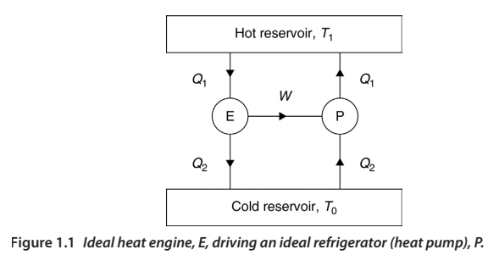
Heat Engine, Heat Pump, and Refrigeration
Heat engine
Heat Pump
Refrigeration
-

Slide 8
Refrigeration:
It is the process of removing heat from a substance under controlled condition.
It is a process of reducing and maintaining the temperature of a body below the general temperature of the surroundings.
Refrigerating machine:

Slide 9
Refrigerant
A refrigerant is a working fluid or thermal medium used for transferring heat within a refrigeration and air conditioning system
It is a medium of heat transfer, which absorbs heat by evaporating at low temperature and gives out heat at high temperature.
A refrigerant must satisfy chemical, physical, safe working, and thermodynamic properties and economical aspects.
Earlier refrigerants used in mechanical and vapour refrigeration systems are:
CO₂, ethyl chloride, SO₂, dichloromethane (CH₂Cl₂), dichloroethylene (C₂H₂Cl₂), monobromomethane (CH₃Br),
Organic (Chloro-fluloro derivatives of CH₄ and C₂H₆ – HCs, HFCs, HCFCs, and CFCs) and inorganic (Ammonia - NH₃, CO₂, air, ).

Slide 10
Classification of refrigerants:
Primary refrigerants, 2. Secondary refrigerants
* Primary refrigerants absorbs heat and generate coolness by changing their phase from liquid to vapour.
They are working media in refrigeration systems which are directly used as carrier of heat.
* Secondary refrigerants absorb heat from the bodies or space to be cooled and further transfer the same to the primary refrigerants.

Slide 11
Classification of refrigerants:
Refrigerants
Primary/Organic
Halocarbons
Azeotropes
Secondary/Inorganic
Unsaturated organic compounds
Inorganic
Hydrocarbons

Slide 12
Halocarbon compounds:
- Fluorinated hydrocarbons from methane, ethane, etc.
Freon, frigen, arcton, etc. (Commerciallly)
Important examples
R11 –Trichloromonofluoromethane (CCl₃F)
R12 - Dichlorodifluoromethane (CCl₂F₂)
R22 - Monochlorodifluoromethane (CHClF₂)
R40 – Methyl chloride (CH₃Cl)

Slide 13
Azeotropes:
This is a mixture of different refrigerants that cannot be separated under pressure and temperature.
Their thermodynamic properties are fixed.
They are refrigerants whose code starts with digit “5” eg. R502
R500 – 73.8% R12 + 26.2% R152
R502 – R22 + R115
R503 – R13 + R23

Slide 14
Hydrocarbons:
Refrigerants derived from hydrocarbons
Desirable thermodynamics properties but highly inflammable
R50 (methane –CH₄)
R170 (Ethane – C₂H₆)
R290 (Propane – C₃H₈)

Slide 15
Inorganic compounds:
Refrigerants sourced from inorganic materials
R717 (Ammonia – NH₃)
R718 (Water – H₂O)
R744 (Carbon dioxide – CO₂)
R729 (Air)
R764 (Sulphur dioxide – SO₂)

Slide 16
Unsaturated organic compounds:
These are refrigerants derived from ethylene and propylene
R1120 (Trichloroethylene – C₂H₄Cl₃)
R1130 (Dichloroethylene – C₂H₄Cl₂)
R1150 (Ethylene – C₂H₄)
R1270 (Propylene – C₃H₆)

Slide 17
Secondary refrigerants:
They absorb heat from refrigerated space/body and transfer it to primary refrigerants for it to be discarded to the environment
Water,
Brines (Calcium chloride – CaCl₂)
Glycols (Ethylene glycol, propylene glycol, etc.

Slide 18
Designation of refrigerants
Naming of refrigerants
Three/four codes (R0123)
First – Number of carbon atoms – 1
Second – Number of hydrogen atoms + 1
Third – Number of fluorine atoms
Four – Number of chlorine atoms
C_{m}H_{n}F_{p}Cl_{O} (Chemical formula)
n + p + o = 2m + 2

Slide 19
R – (m - 1) (n+1) (p)
Examples (halogencarbon)
R22 or R022
m – 1 = 0 m = 1
n + 1 = 2 n = 1
p = 2
Using n + p + o = 2m + 2
o = 1
R22 = CHClF₂

Slide 20
Designation for inorganic refrigerants
According to molecular weight
Molecular weight is added to 700
*Eg. water (H₂O) = 18 (molecular weight)
R700 + 18 = R718
* Eg. ammonia (NH₃) = 17 (molecular weight)
R700 + 17 = R717

Slide 21
Desirable Properties of a refrigerant
Chemical properties,
Physical properties,
Thermodynamic properties

Slide 22
Chemical Properties
Flammability (inflammable before air or oil)
Toxicity (not poisonous)
Action of refrigerant with water
Corrosiveness
Leak detection/tendency (low)
Flash point (high)
Miscibility with oil
Stability (chemically and physically)
Environmentally friendly

Slide 23
Physical Properties
Specific volume (low)
Viscosity (low)
Thermal conductivity (high)
Dielectric strength (high)
Handling and maintenance (safe)
Cost and availability (low cost)

Slide 24
Thermodynamic Properties
Latent heat of vaporization (high)
Boiling point (low at atmospheric temp.)
Freezing temperature (below evaporator temp.)
Evaporating pressure (above atm. Pressure)
Condensing pressure (low)
Critical temperature and pressure (above condensing pressure)
Index of compression process (small)

Slide 25
Properties of an ideal refrigerant
It should have zero ODP and zero GWP
It should be non-toxic and non-flammable
It should be non-corrosive
It should have high latent heat
It should have high critical pressure and temperature
It should have low condensing pressure and the evaporating pressure should be slightly above the atmospheric pressure
It should not be miscible with lubricating oil
It should be easily available and cheap
Leak detection should be easy
It should be environmentally friendly

Slide 26
Refrigerant selection
Working temperatures of the refrigerant
Evaporator and condenser pressures needed and the pressure ratio
Oil miscibility
High latent heat of vaporization and low specific volume
Toxicity, flammability, explosiveness and corrosiveness
Space requirements

Slide 27
New refrigerants
R134a replaces R12
R123 replaces R11
Bio-based refrigerants
Nano-based refrigerants

Slide 28
Desirable properties of secondary refrigerants
They should have low freezing point
They should have good stability
They should have low vapour pressure
They should have high heat transfer coefficients
They should have high specific heat
They should be non-flammable

Slide 29
Advantages of secondary refrigerants
They can be easily handled
Adjusting the temperature allows the cooling of different rooms in a building
Control is easy
Piping size required is reduced
Absolute safety in air conditioning installation due to leakage

Slide 30
Class assignment
Discuss the effect of chlorofluorocarbons and hydrogen chlorofluorocarbons on the environment and the way forward.
What do you understand by nano-based and bio-based refrigerants?
What do you understand by environmentally friendly?

Slide 31
Vapour Compression Refrigeration
Components
Evaporator
Compressor
Condenser
Expansion valve

Slide 32
Types of Refrigeration Cycles
Ideal cycle
Simple vapour compression cycle
Transcritical cycle
Heat powered cycles (absorption, adsorption and desiccant cooling)
Stirling cycle
Thermoelectric cooling
Magnetic refrigeration

Slide 33
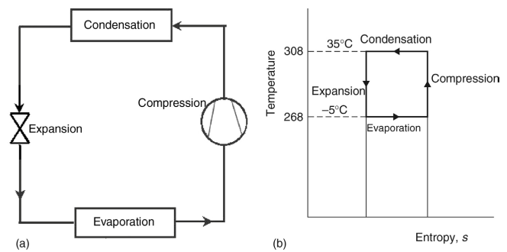

Slide 34
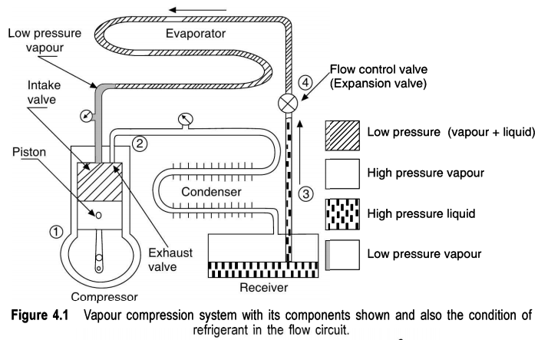
Schematic diagram

Slide 35
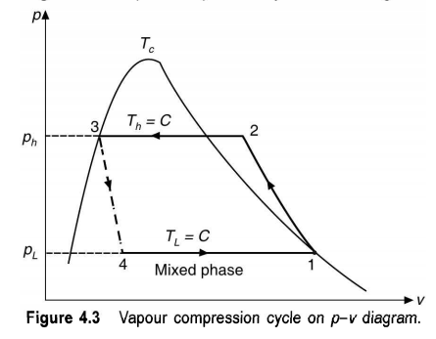
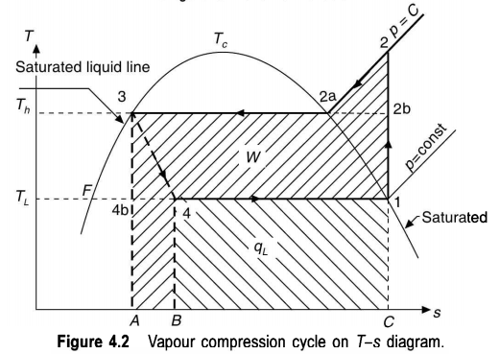
P-vxxxxxxxxxxxxxxxxxxxxxxxxxxxxxxxxxxxxxxxxxxxxxxxxxxxxxxxxxxxxxxxxxxxxxxxxxxxxxxxxxxxxxxxxxxxxxxxxxxxxxxxxxxxxxxxxxxxxxxxxxxxxxxxxxxxxxxxxxxxxxxxxxxxxxxxxxxxxxxxxxxxxx

Slide 36
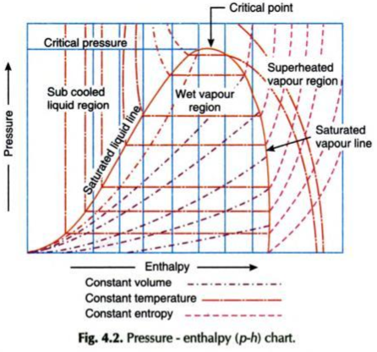

Slide 37
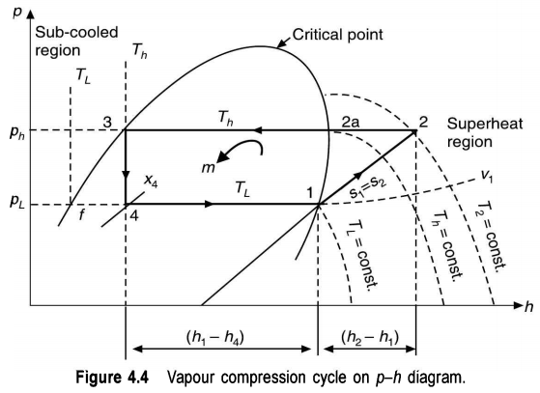
Processes
Compression (1-2)
(Isentropic compression
s₁=s₂; q=0; W=h₂-h₁)
Condensation (2-3)
(superheating and condensation
at constant pressure)
Heat rejected, q_{h}=h₂-h₃
Expansion (3-4)
Evaporation (4-1)

Slide 38
Processes
Expansion (3-4)
(Isenthalpic expansion;
h₃=h₄=hf₄+a(h₁-h₄))
Evaporation (4-1)
Evaporation at constant
Pressure (P_{L})
Refrigerating effect (q_{L})=
h₁-h₄

Slide 39
Processes
For cooling,
_{COPR = h1-h4/h2-h1}
_{For heating,}
_{COPR = h2-h3/h2-h1}
Refrigerant flow rate, m= total refrigerating effect/refrigerating effect per unit mass
_{= QL/qL}
Volume of suction vapour, V = mυ1
Actual piston displacement, Vp = mυ1/ηv
Mass flow rate per ton of RE, ṁ = 3.5164/qL (kg/s)
_{W* = w = 3.5164/qL w}

Slide 40
Types of vapour compression cycles
Cycle with dry saturated vapour after compression
Cycle with wet vapour after compression
Cycle with superheated vapour after compression
Cycle with superheated vapour before compression
Cycle with undercooling or subcooling of refrigerant

Slide 41
Next class:

Slide 42
Next class:

Slide 43
Next class:

Slide 44
Next class:

Slide 45
Next class:

Slide 46
Next class:

Slide 47
Next class:

Slide 48
Next class:

Slide 49
Next class:

Slide 50
Next class:

Slide 51
Next class:

Slide 52
Next class:

Slide 53
Next class:

Slide 54
Next class:

Slide 55
Next class:

Slide 56
Next class:

Slide 57
Next class:

Slide 58
Next class:

Slide 59
Next class:

Slide 60
Next class:

Slide 61
Next class:

Slide 62
Next class:

Slide 63
Next class:

Slide 64
Next class:

Slide 65
Course grade distribution:
Tests (1 and 2) – 10 marks each = 20 marks
Quizzes, Assignments and attendance – 10 marks
Examination – 70 marks
Practical – 40%
Theory – 60%
Total – 100 marks
Note: minimum of 70% class attendance qualifies you for the examination

Slide 66
What do you understand by “Engineering”?

